Slide 1
Build 2: a script and
its measurement
Does my automation really save time and cut errors?
Applied AI and Automation | Session 8 of 12
KLAi Professional Learning | Jotham Martin Wambi
Notes:
Welcome to the second build session. Last time you set the limits for an automation. Today you run a real script on a practice sheet of sample data, test it ten times and measure whether it saves time and cuts errors. A measured number is what you can show at the next board meeting.
The question for today is this: Does my automation really save time and cut errors? Keep it in mind. At the end of the session we come back to it and see how much more you can say.

Slide 2



Today in one view: what you will leave with
By the end of today you will have
A working Apps Script automation, run from your own copy of the practice sheet, with the secret key stored safely
A test log of ten tests, each with the result you expected and the result you got
One result line: how many minutes saved per run and how many errors found, against your Session 1 baseline
Notes:
Here is what you leave with. A working script on your own copy of the practice sheet. A test log with ten tests. And one result line that says how many minutes you saved per run and how many errors were found, compared with the baseline you wrote in Session 1.
Sixty minutes today are yours, so we move quickly through the ideas.

Slide 3
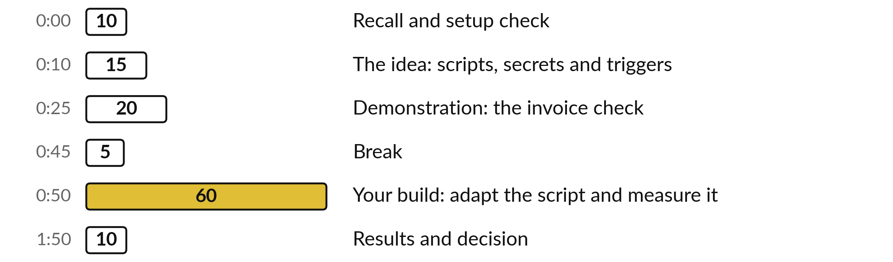
Your two hours: most of
the time is your own work
60 of the 120 minutes are yours: adapt the script, run ten tests and measure.
Notes:
Ten minutes of recall and setup check, fifteen minutes on the idea, then twenty minutes on a demonstration where I run the invoice check. After the break you have sixty minutes to adapt the script and measure it. The last ten minutes are for your result and your decision.

Slide 4

Three questions from last time
1. What goes on a tool boundary sheet?
2. Name one stop condition for an automation.
3. Why does an automation that reads incoming email need extra care?
Answer aloud first. Then we check together.
Notes:
Three quick questions from Session 7. Answer aloud first, and then we check together. It is a warm-up to bring last time back.
Question one. What goes on a tool boundary sheet? Take a moment.
A good answer is this. What the automation may read, write and send, what it must never do, what a person approves, its limits, its stop conditions, its off switch and its owner.
Question two. Name one stop condition for an automation. Say it to yourself first.
A good answer is this. Any figure is missing, a total differs from the sheet, a run takes too long, or the AI returns a figure that is not in the source.
Question three. Why does an automation that reads incoming email need extra care? Think about your own task as you answer.
A good answer is this. Incoming text can hide an instruction (prompt injection). Treat it as data and keep a person approving every action.
If an answer was missing, your own task card or last workbook page has it. Now to today.

Slide 5



Words we use today
Word | What it means
Script | A small program. Here it is three files of code that sit inside your copy of the practice sheet.
Trigger | In Apps Script, a timer or event that starts a script by itself, such as Monday at 7. It runs as its owner.
Script Properties | A private store inside the project where the secret key lives. The code reads it by name.
Dry run | A run that calculates and logs but changes nothing: no draft and no new sheet.
Run log | A sheet where every run adds one line: time, script, mode and a summary.
Notes:
Five words for today. I give the plain meaning of each, and we use every one of them before the end of the session.
Script. A small program. Here it is three files of code that sit inside your copy of the practice sheet.
Trigger. In Apps Script, a timer or event that starts a script by itself, such as Monday at 7. It runs as its owner.
Script Properties. A private store inside the project where the secret key lives. The code reads it by name.
Dry run. A run that calculates and logs but changes nothing: no draft and no new sheet.
Run log. A sheet where every run adds one line: time, script, mode and a summary.

Slide 6
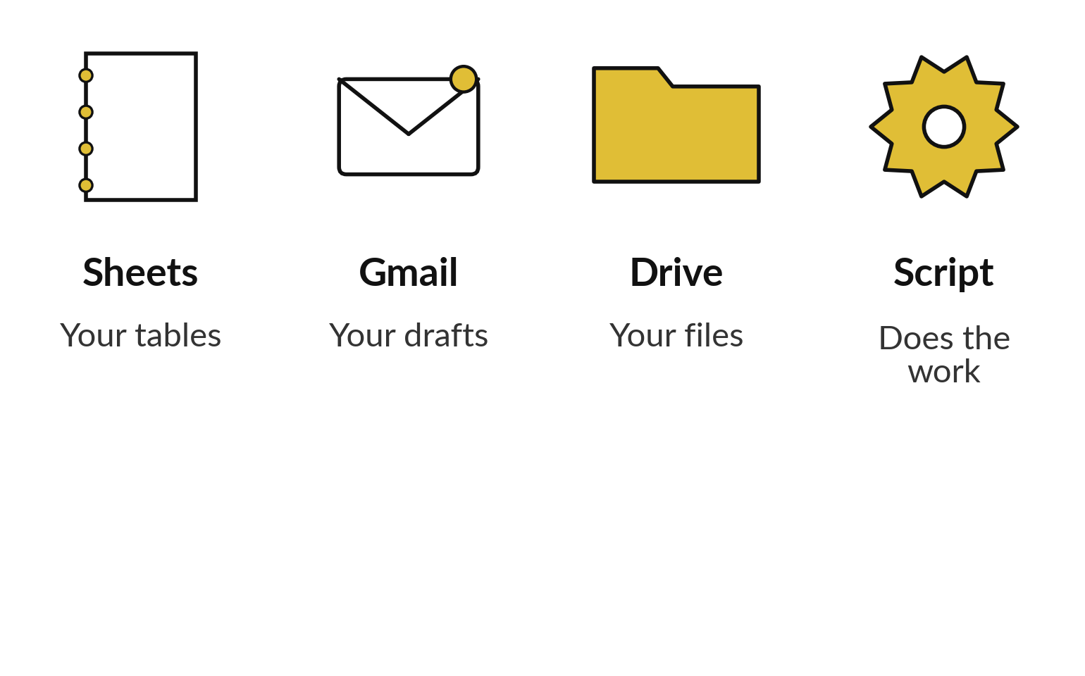
Apps Script is small programs
inside your own Google account
Small programs that live inside your Google Sheet, Gmail and Drive.
Free with a Google account.
It runs on Google’s servers, even when the sheet is closed.
We start with scripts that only read and draft.
Notes:
Google Apps Script sounds technical, so here it is in plain words. It is small programs that live inside your Google Sheet, Gmail and Drive. It is free with a Google account, and it runs on Google’s servers, so it can run on Monday morning while your laptop is shut.
Today the scripts only read your sheet and save drafts. They never send an email and they never change your data. You read short code and change three words. The scripts are already in your own copy of the practice sheet, so your setup is only your account and its permissions.

Slide 7
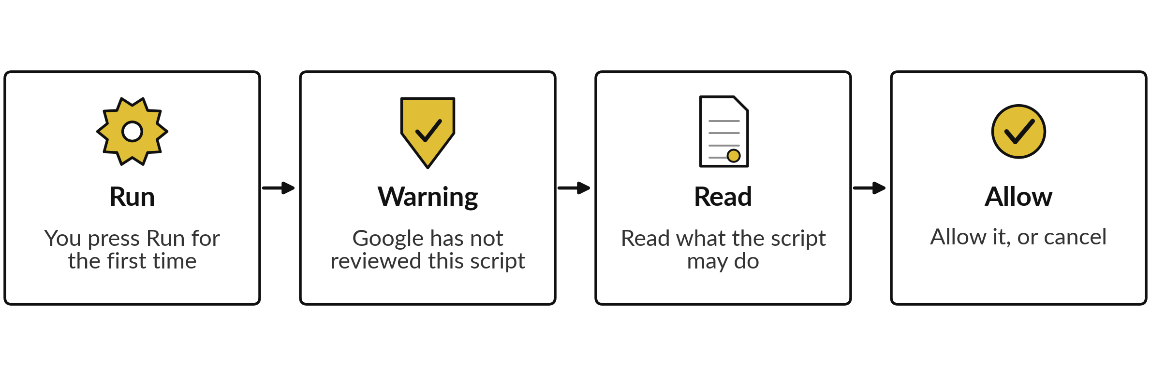
The first run asks your permission,
and you can take it back
Typical sequence, your screen may differ. Remove access later at myaccount.google.com/permissions.
Notes:
The first time you run a script, Google asks for permission. You will see a warning in words close to this: Google has not reviewed this script. That is normal for a script that you or your instructor pasted in, because nobody at Google has checked what it does.
So you check: read the list of what it may do before you allow it. The Gmail wording is broad even though our script only creates drafts, which is why we use a dedicated course account. You can remove the permission at any time at myaccount.google.com/permissions. Your screen may word these steps differently, so follow your screen.

Slide 8



Two supplied scripts do the work
and one helper keeps them safe
Script | What the code does | What it never does
weekly_digest | Adds up each region, works out the change on last week, saves a draft email. | Send an email.
invoice_check | Flags wrong totals, duplicates, missing purchase order numbers and zero VAT. | Change your invoice sheet.
ai_helper | One safe call to the AI, the run log and the off switch. | Add up or flag anything.
Notes:
Three files. The weekly digest reads your sales sheet, adds up each region, works out the change on the week before, and saves a draft email. It creates a draft and never sends, so a person reads the email before anything leaves the company. The invoice check reads a sheet of invoices and flags wrong totals, duplicate invoices, missing purchase order numbers and zero VAT.
It only reads your sheet. The third file is a helper with one safe call to an AI model, the run log and the off switch. Notice that the arithmetic and the flagging are plain code. That is a deliberate choice.

Slide 9
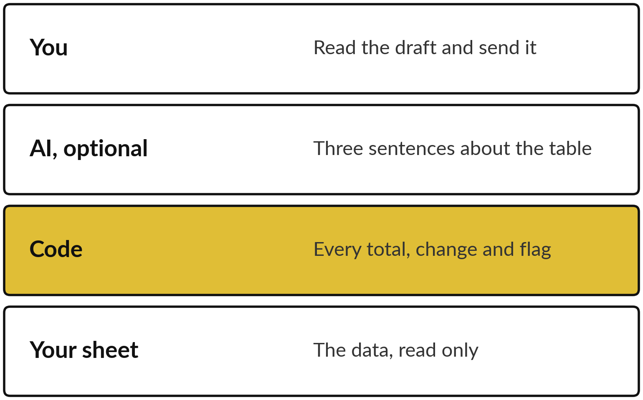
The code does the sums and
the AI may only describe them
Numbers come from code. Words may come from AI.
Code gives the same answer every run.
Check each AI sentence against the table.
Switch the AI off and the script still works.
Notes:
Remember the Session 1 rule: if a rule can do it, use a rule. Adding invoices is a rule, so plain code does it and gets the same answer every time. The AI has one optional job, which is to write three sentences about a table the code already built.
Read each of those sentences against the table, because an AI can state a number that is not there. If you switch the AI off, the script still produces the full table. The person at the top, you, reads the draft and decides whether to send.

Slide 10
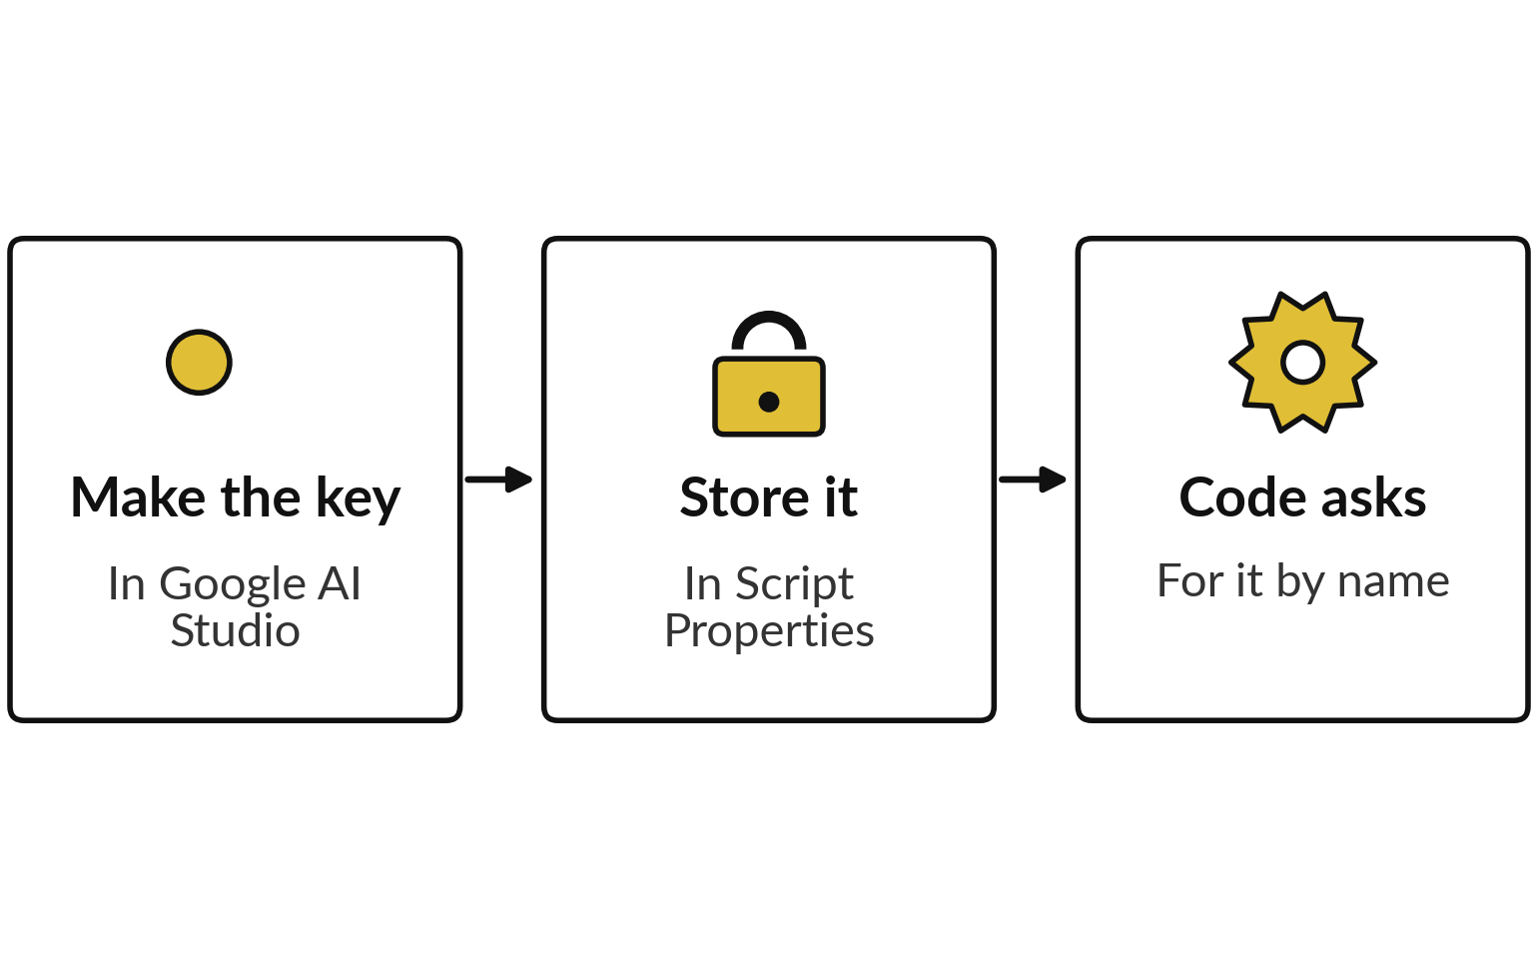
Keep the secret key in Script
Properties, never in the code
A key in the code is a password on the wall.
Never paste it in a chat, email or screenshot.
If it leaks, delete it and make a new one.
Notes:
If the AI step is on, the script needs a key from Google AI Studio. Think of a key in the code as a password written on the wall. Anyone who sees the code, a copy or a screenshot has the key. So you store it in Script Properties, a private store in the project settings, and the code asks for it by name, as the three steps show.
Never paste it in a chat or an email. If it leaks, delete it in AI Studio and make a new one. The free key also has a data rule that comes next.

Slide 11





Five limits to know before you press Run
Limit (quotas change, check the current limits) | Value to teach
Your data and account | Sample or sanitised data, in a personal Google account. A company Workspace needs IT approval.
Email recipients a day | 100 on consumer Gmail, 1,500 on Workspace
One run of a script | Stops at 6 minutes
Web calls a day, consumer account | 20,000
Free Gemini key | Fake or sample data only: free-tier content may be used to improve Google products
Quotas change. We re-check them in a real account on the day.
Notes:
Five limits. First, your data and account: sample or sanitised data, in a personal Google account. A company Workspace needs IT approval, because many companies switch scripts off. Email recipients a day: a hundred on a consumer Gmail account and fifteen hundred on Workspace. One run stops at six minutes, so a script for a huge sheet needs splitting.
Web calls a day are generous on a consumer account. The last row matters most. On a free Gemini key, what you send may be used to improve Google products. So with a free key you use fake or sample data only. Real customer or staff data waits for a paid, approved set-up. These figures change, so I re-check them in a real account.

Slide 12
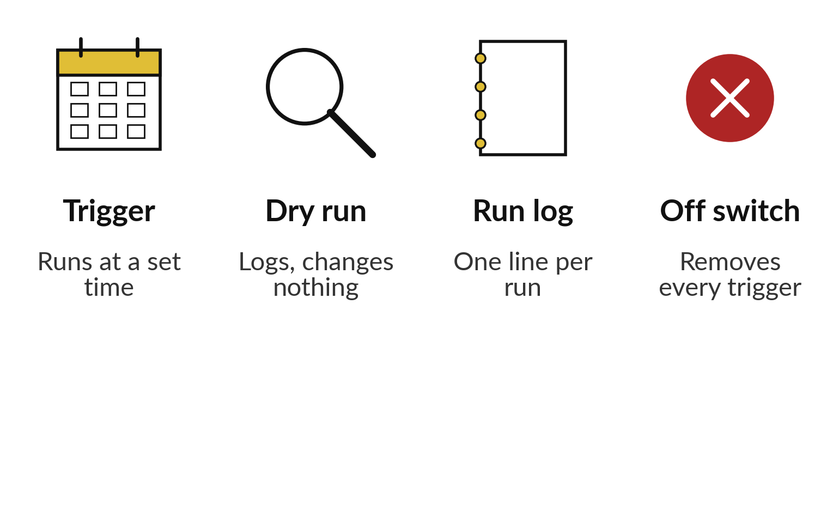
Triggers run alone, so start in
dry run and keep an off switch
Switch on only when the numbers match your own check.
Every script starts in dry run.
A trigger runs as its owner and stops if that account is deleted.
Two people know the off switch.
Notes:
In Apps Script a trigger is a timer or an event that starts a script by itself, for example every Monday around seven. That is the saving, and also the risk, because a wrong script now runs without anyone watching. So every script starts in dry run: it calculates and logs and changes nothing.
Every run adds one line to the run log. The off switch is a function that removes every trigger. A trigger runs as its owner, the account that created it. If that account is deleted or loses access to the sheet, the trigger stops. So name one owner, and make sure a second person also knows where the off switch is.
You switch the trigger on only when the numbers match your own check.

Slide 13
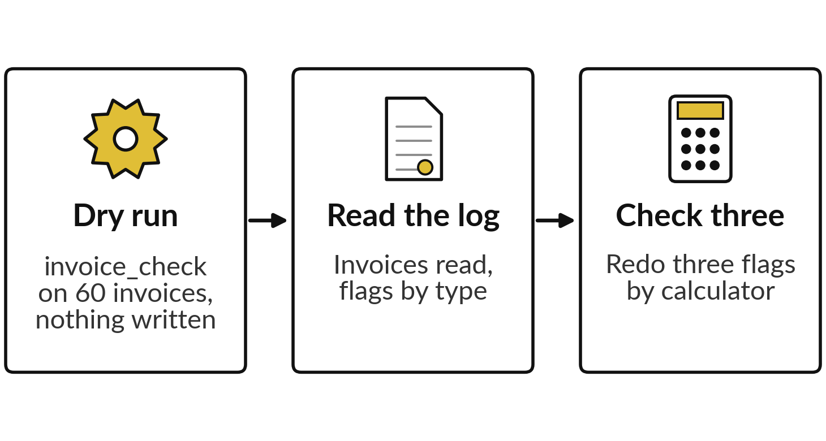
Demonstration: run invoice_check
on the supplier invoices
I will show
Watch for
Which flags are errors and which need a person to decide.
What the detail column says about each flag.
The flags themselves. You will see them in class.
Notes:
Now I run the invoice check on the sixty supplier invoices of Nile Valley Foods. The three steps on the left are my plan. First in dry run, so nothing is written. I read the run log line, which tells us how many invoices were read and how many flags of each type.
Then I take three flags and check them with a calculator, so you see that the code is testable. Watch which flags are real errors and which need a person to decide, such as a zero VAT line. You will see the flags in class, so count your own first.
Before the break, each of you names one flag you would send to a person to decide.

Slide 14
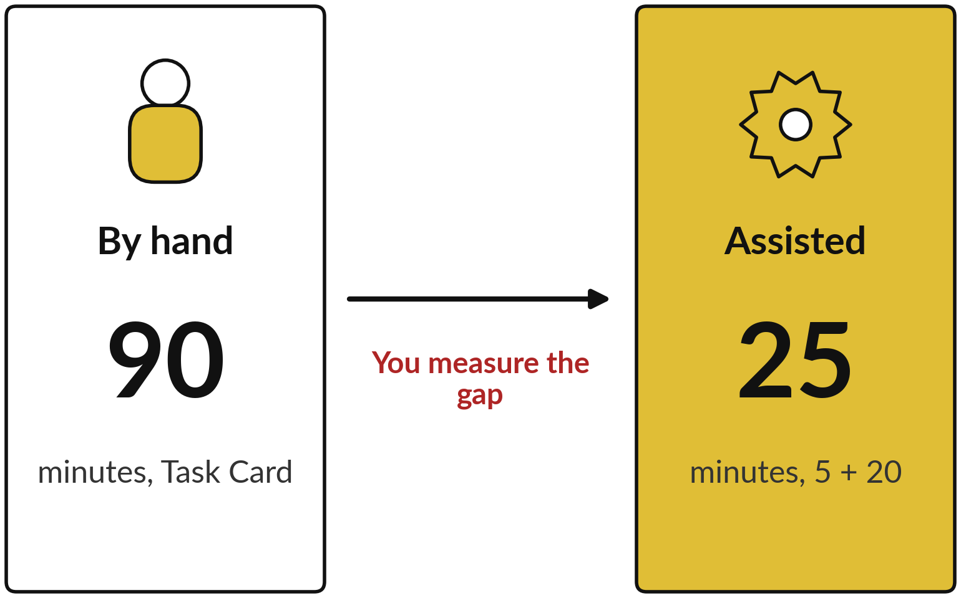
The comparison to make: by hand,
assisted, and the errors you count
“__ minutes saved per run, __ errors found.”
By hand: time one region and scale it up to all regions.
An error: a figure in the hand summary that differs from the script’s total.
Fill the blanks only from your test log.
Notes:
Here is how we measure, using the Nile Valley Foods Task Card from Session 1. The by-hand time is your Task Card baseline: time one region by hand and scale it up. Twelve minutes for one region and six regions make seventy-two minutes. Their card says ninety. The assisted time is start plus review: five minutes to start and twenty to review is twenty-five, and review counts as a cost.
An error is any figure in the Sales Manager’s hand summary that differs from the script’s total for the same week. You count those yourself in the practice. The blanks come only from your test log.

Slide 15
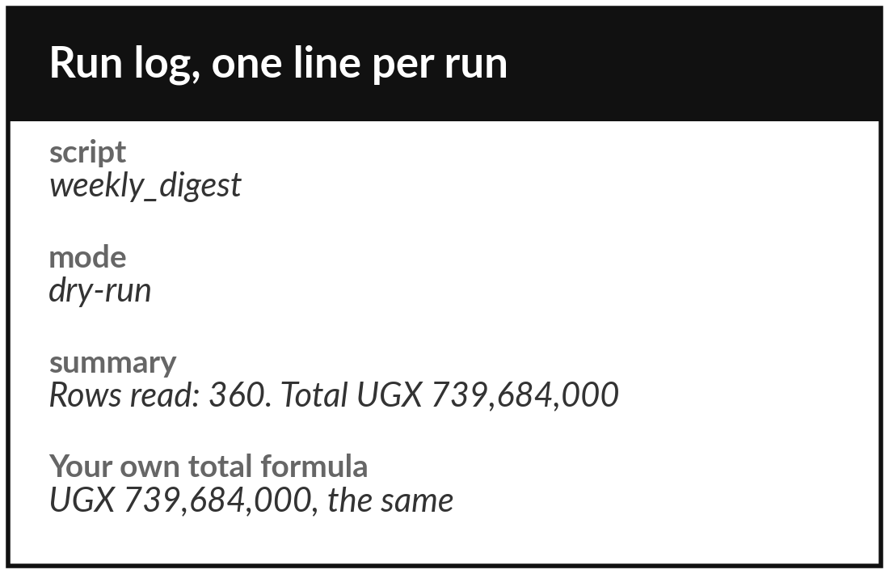
Practice: change three words and run in dry run
20 minutes
Your own company task
Run the NVF data, then your own sample data.
Make your copy of NVF Apps Script Practice.
Run createWeeklyDigest in dry run. Read the Run log line.
Check the total with your own SUMIFS formula.
Change three words for a sample sheet of your own task, or keep the NVF data.
You keep: A total that matches your formula, and the Run log line.
Notes:
Take twenty minutes. Make your own copy of the practice sheet: File, then Make a copy. Run the weekly digest in dry run, read the run log line, and check the total with a SUMIFS formula of your own. If the two numbers differ, stop and call me.
Then read the three lines at the top of the weekly digest and change the three words: the tab name, the heading to group by and the heading to add up. To use your own task, build a copy of its sheet with sample or sanitised data in your personal account.
A company Workspace needs IT approval first. Keep the script in dry run.

Slide 16
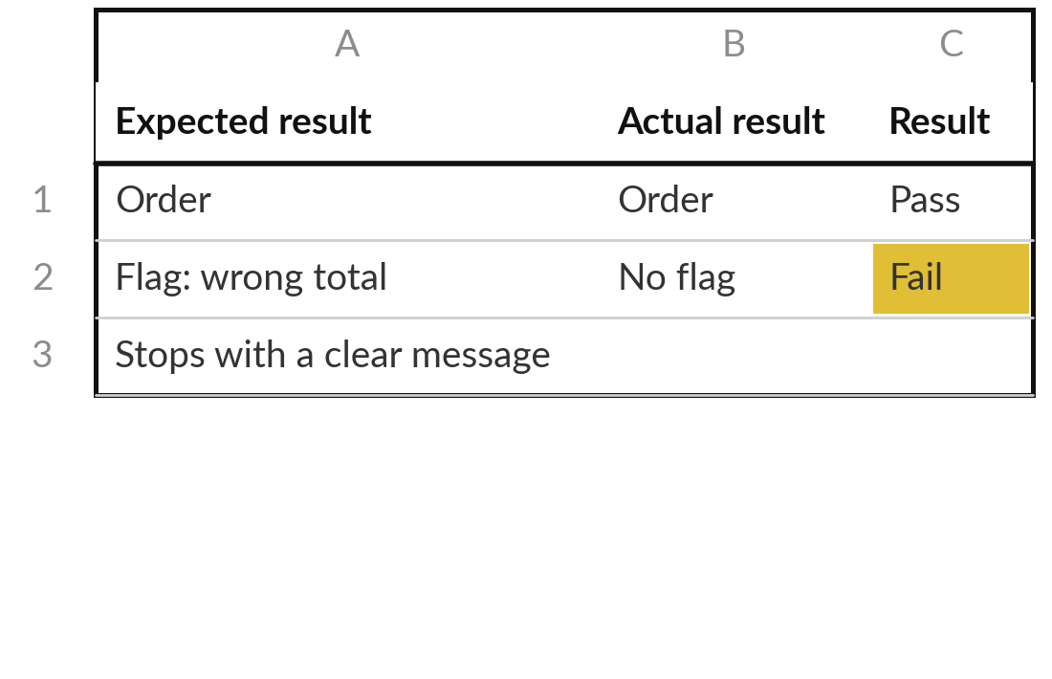
Practice: run ten tests and record each one
25 minutes
Your own company task
Fill ten rows of the Automation Test Log.
Type your target pass rate before you start.
Write the input, the expected and the actual result for each test.
Include two tests that break it on purpose, such as a wrong tab name.
Time start and review in their own columns. Assisted time is start plus review.
You keep: A test log with ten rows, a pass rate and the error types you found.
Notes:
Twenty-five minutes for ten tests. First, type the pass rate you need before relying on the script, so you cannot move the goalposts afterwards. Then for each test write what you gave it, what you expected and what you got. Include two tests that break it on purpose, for example rename the tab or blank one cell, and see whether the script stops with a clear message.
Time the job by hand once, and for the script write the minutes to start and the minutes to review in their own columns. The sheet adds the two to give your assisted time.

Slide 17
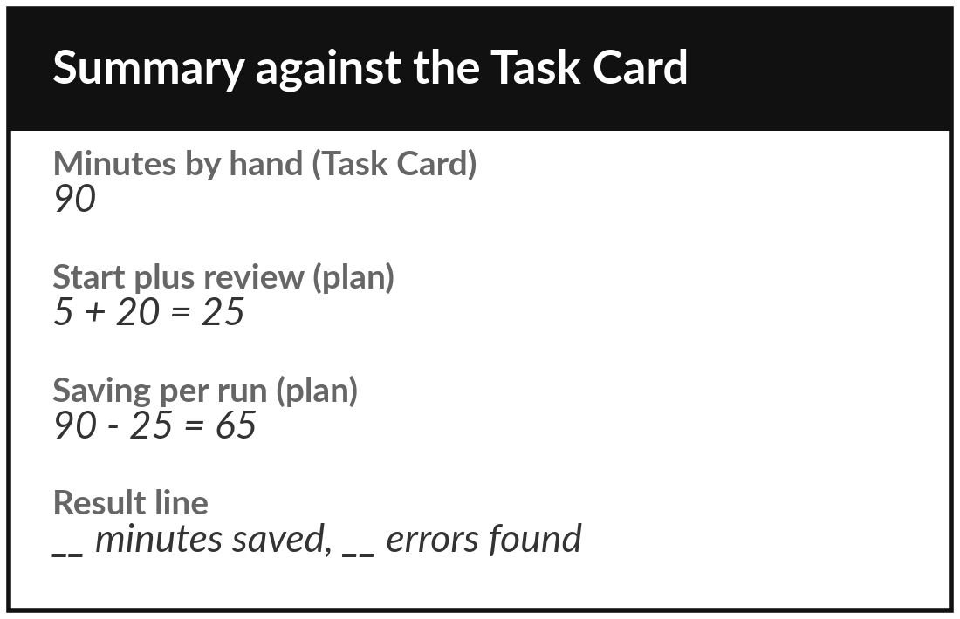
Practice: compare with your
baseline and write one line
15 minutes
Your own company task
Put the log summary next to your Session 1 Task Card.
Read the pass rate and minutes saved on the Summary sheet.
Compare the minutes by hand with your Task Card baseline.
Open the hand_summary tab and count the figures that differ from the script’s totals.
Write: X minutes saved per run, Y errors found.
You keep: One result line, backed by ten logged tests.
Notes:
Fifteen minutes to measure. Open the Summary sheet and read the pass rate and the average minutes saved. Put it beside your Task Card from Session 1. Is the time by hand in your log close to your baseline, or was your estimate wrong?
Then open the hand summary tab and compare each weekly figure with the script’s total for the same week. Count the figures that differ. I tell you the right number after you have counted. If your own task has no hand summary, use the usual errors line of your Task Card. Finish with one line: minutes saved per run, and errors found.

Slide 18



Decision: keep, change or stop this automation?
What does your test log say you should do?
Keep
Change
Stop
Pass rate meets your target and the saving is real. Name an owner and a review date.
Close, but some tests fail. Fix, retest and decide again.
The saving is small or the errors are risky. Say so and move on.
Write the decision, the owner and the review date on the test log.
Notes:
Time to decide, and your test log is the evidence. Keep it if the pass rate meets the target you wrote before testing and the saving is real; then name the owner and a review date. Change it if you are close but some tests fail; fix them, retest and decide again.
Stop if the saving is small or the errors are risky. Stopping is a good result, because you learned it for the price of one afternoon. Write the decision, the owner and the review date.

Slide 19
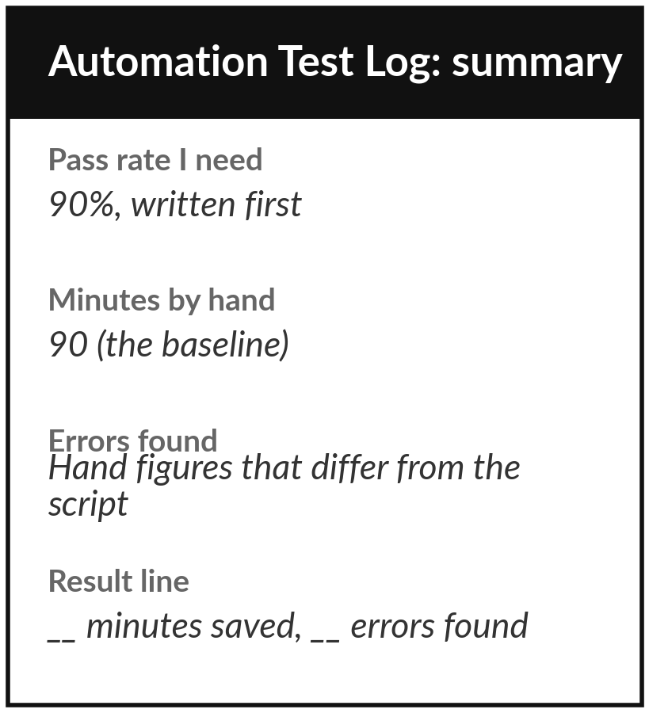
Save it, and bring one question to the next session
What you keep from today
Your working script, your measured test log and one result line: “X minutes saved per run, Y errors found.”
Our question today
Does my automation really save time and cut errors?
Next session
Session 9: Risk, security and the law. You will list what could go wrong with your task and draft your company AI-use policy.
Notes:
Save the script, the test log and your result line. Write the owner of the automation on the log, and write who can switch it off. If you like, ask yourself one optional question before next session: if this automation made a mistake tomorrow, who would be hurt first? That question starts the risk register.
We began with this question: Does my automation really save time and cut errors? Before you go, say in one sentence what you can now say about it.

